Slide 1

Wyndham Grand Plaza Royale Hainan Longmu Bay
海南龙沐湾温德姆至尊豪廷大酒店

Slide 2

About Greater China Hospitality (H.K.) Company
大中華酒店（香港）有限公司简介
Slogan 标语
Care | Commitment | Delivery
关怀 承诺 履行
Two Brands Be Developed and Managed in Greater China
大中華地区拓展及管理两大品牌：
Wyndham Grand Plaza Royale Hotels & Resorts
温德姆至尊豪廷酒店及度假村
Howard Johnson Hotels & Resorts
豪生酒店及度假村

Slide 3




About Greater China Hospitality (H.K.) Company
大中華酒店（香港）有限公司简介
Scan and follow us on Wechat
扫一扫，即可关注GCH官方微信
Scan and follow us on Sina Weibo
扫一扫，即可关注GCH官方微博

Slide 4

Brand Briefing 品牌简介
Wyndham Grand Plaza Royale Hotels & Resorts offer a high-end platinum five-star hotel experience to guests who intend to indulge and fully enjoy their stay in extravagance. Guests will notice and appreciate the lavish room accommodations and the little details that make all the difference and transform your hotel stay into an oasis of comfort, style and elegance.
温德姆至尊豪廷酒店及度假村品牌为追求奢华享受的宾客提供高端白金五星级别的酒店体验。极尽奢华的客房设备与细节的精致处理将使我们的宾客得到前所未有的，舒适、格调、优雅的酒店全新体验。

Slide 5
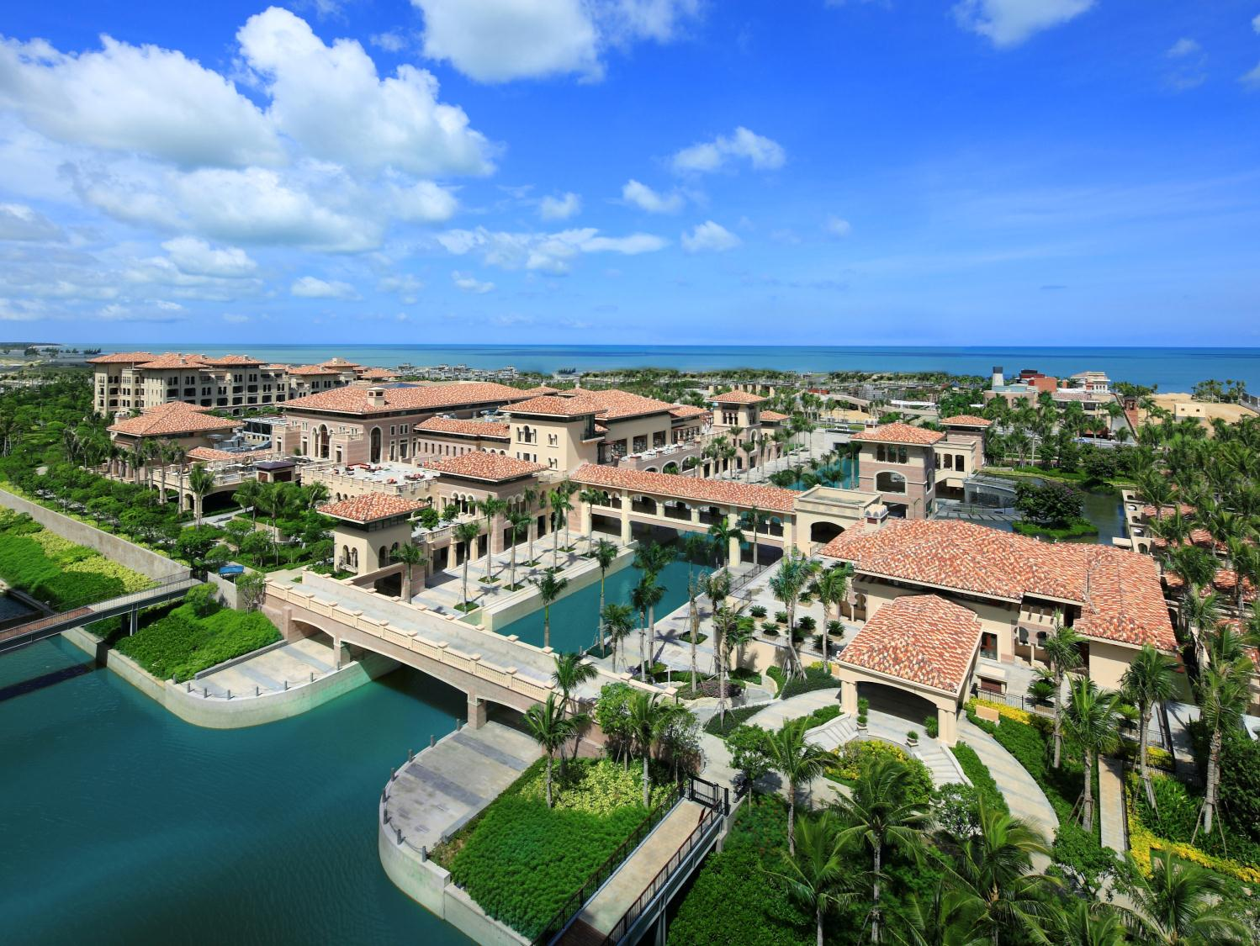
Discovery of the Most Beautiful Backyard of Sanya
探秘三亚最美后花园

Slide 6

Wyndham Grand Plaza Royale Hainan Longmu Bay
海南龙沐湾温德姆至尊豪廷大酒店

Slide 7
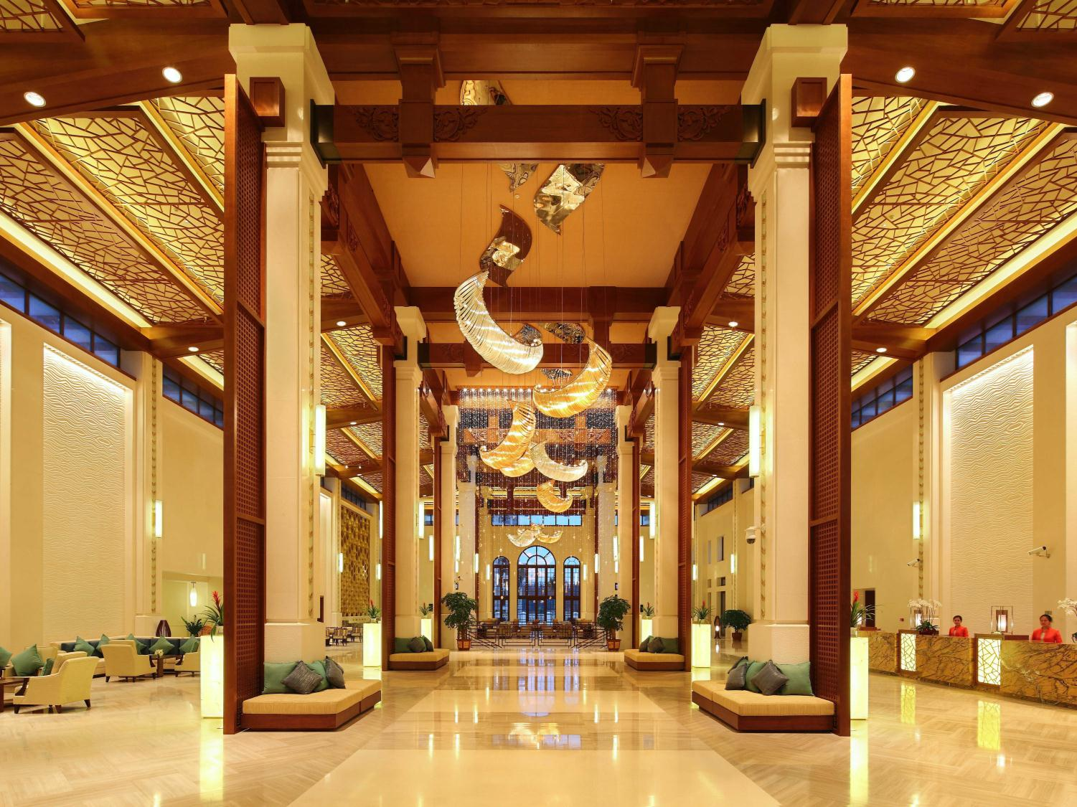
Your New Destination Where Luxury Is Redefined
豪华新地标 华贵新诠释

Slide 8
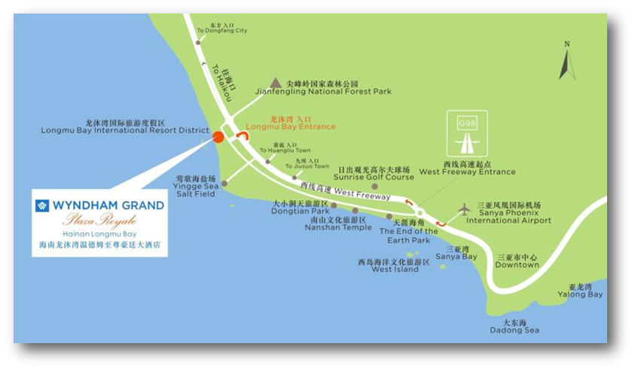
Hotel Overview
酒店概况
Situated on the south west coast of Hainan Island, the Wyndham Grand Plaza Royale Hainan Longmu Bay has perfectly balanced multiple resort elements such as luxury guestrooms, delicious cuisines, countless recreational activities and expansive gardens, providing you a great opportunity to indulge yourself in the magnificent tropical landscaping and the most beautiful sunset.
海南龙沐湾温德姆至尊豪廷大酒店位于世外桃源般的海南西南海岸，完美融合了舒适客房、美食歆享、纵情娱乐等众多度假元素，让您在瑰丽的热带花园和最美夕阳景色中乐而忘返。

Slide 9



City Hot Spot: the Most Beautiful Sunset Beach
城市热点——最美夕阳
Facing the South China Sea from due west, Longmu Bay possess the most beautiful sunset in China
龙沐湾海岸正西朝向中国南海，是中国最美的落日海滩
Located at heart of Longmu Bay, hotel private beach is the perfect place to enjoy splendid sunset view
酒店专属海滩位于龙沐湾中心地段，是欣赏海上夕阳瑰丽景观的绝佳地点

Slide 10



City Hot Spot: Jianfeng Mountain National Forest Park
城市热点——尖峰岭国家森林公园
25 minutes from Jianfeng Mountain National Forest Park
25分钟车程即可抵达 尖峰岭国家森林公园
The existing largest and the most well preserved primeval tropical forest in China with extremely high negative oxygen ion volume
是中国现存面积最大、保存最完整的原始热带森林区，负氧离子含量含量极高

Slide 11



City Hot Spot: Yingge Sea Salt Field
城市热点——莺歌海盐场
20 minutes from Yingge Sea Salt Field
20分钟车程即可抵达莺歌海盐田
The largest sea salt field of Southern China with snowwhite salt hills scenery where still reserves the ancient salt-making craftsmanship
南中国最大的海盐场，能欣赏到皑皑白雪般的盐山和古方制盐工艺

Slide 12
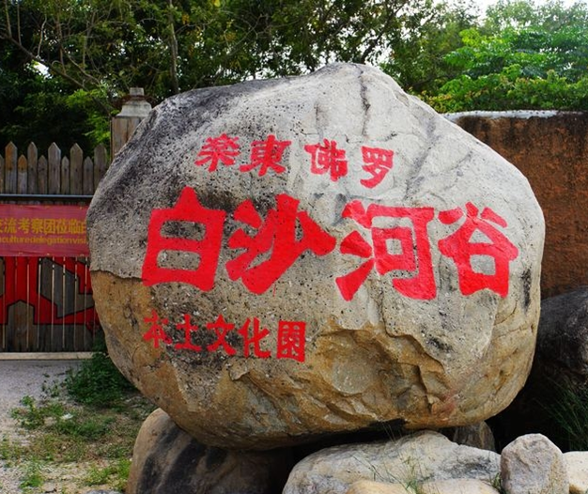
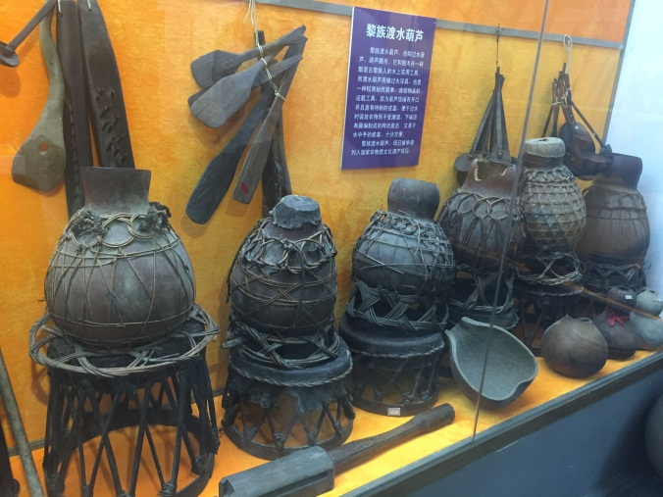
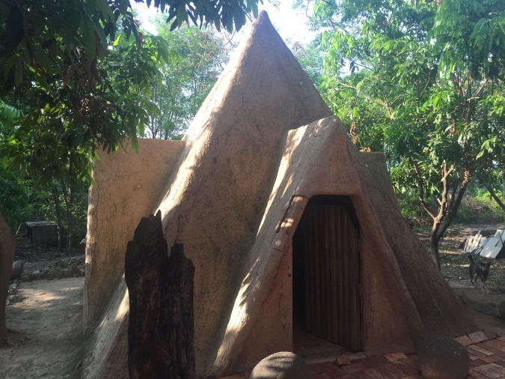
City Hot Spot: Baisha Valley
城市热点——白沙河谷
10 minutes from Baisha Valley
10分钟车程即可抵达 白沙河谷
A private museum with 4000 more Hainan cultural relics reserved, which is an authorized Hainan traditional culture exhibition center.
私人博物馆，陈列了4000余件海南民俗工艺品及文物，文物数量庞大、种类繁多、历史悠久、价值高昂，是权威的
海南民俗文化展示基地

Slide 13


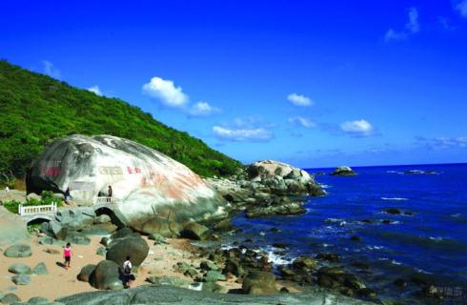


City Hot Spot
城市热点
Nanshan Temple – 40mins by car
南山寺 佛教文化苑 – 约40分钟车程
End of the Earth Park - 60mins by car
天涯海角 – 约60分钟车程
Dongtian Park – 30mins by car
大小洞天 – 约30分钟车程
Chairman Mao Mountain – 70mins by car
毛公山 – 约70分钟车程

Slide 14
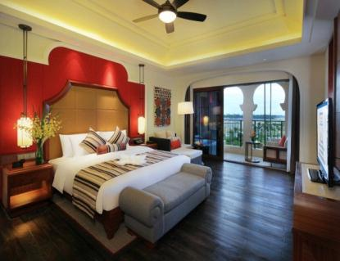
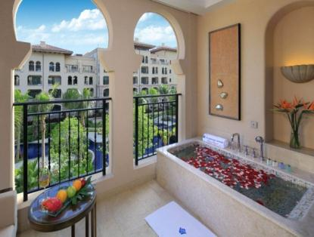
Stylish Guest Rooms & Suites
典雅客房 舒适体验
Hotel offering 362 oversized luxurious guest rooms and suites. Every room is exquisitely appointed and include a private balcony with hot spring bath which enables you to unwind and marvel at the unrestricted views. Complimentary high-speed Internet access and large work spaces make in-room work trouble-free.
海南龙沐湾温德姆至尊豪廷大酒店共有362间充满东南亚异域风情的精致客房和套房，均设有私家庭院和阳台温泉泡池。细致周到的客房设施包含免费高速网络服务，无论是商务旅行还是休闲度假都能让您在宽敞的客房空间里无忧互联。
Room Category | 房型 | 面积(m2) | 双床(Twin) | 大床(King) | 数量 (no.)
Superior Garden View Room | 高级花园房 | 68 | 116 | 76 | 192
Deluxe Pool View Room | 豪华池景房 | 68 | 51 | 25 | 76
Deluxe Pool Access Room | 豪华池畔房 | 83 | 42 | 14 | 56
Superior Suite | 高级套房 | 136 | - | 10 | 10
Deluxe Suite | 豪华套房 | 136 | - | 13 | 13
Deluxe Garden Suite | 豪华花园套房 | 136 | - | 6 | 6
Deluxe Family Suite | 豪华家庭套房 | 272 | - | 6 | 6
Wyndham Grand Suite | 温德姆豪华大套房 | 272 | - | 2 | 2
Presidential Suite | 总统套房 | 700 | - | 1 | 1
Total |  |  | 209 | 153 | 362

Slide 15
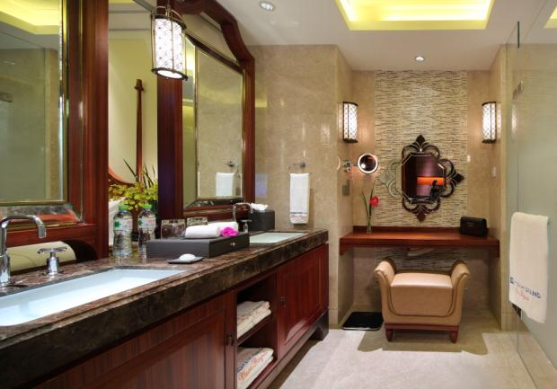
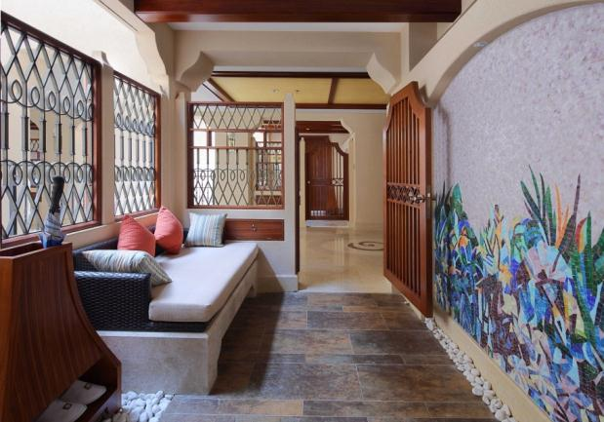
Stylish Guest Rooms & Suites
典雅客房 舒适体验
In-room facilities & service
Central air-conditioning system
24 hours hot-water
Free Wi-Fi
42” flat screen television
International satellite TV programs
In-room digital electronic safe
Mini bar
110V volts socket
Digital telephone with IPod docking
Stainless steel electric kettle
Hair dryer
Alarm clock
Iron & ironing board
Separated shower room & toilet
Spacious balcony with bath tub
Children amenities
Bathrobe & umbrella
Non smoking & handicapped room
Evening turn-down service
24hrs room service
室内设施与服务
中央空调
24小时热水服务
免费无线和宽带上网接口
42寸液晶平板电视
国际国内卫星频道
客房电子保险箱
迷你酒吧
110V 电源插座
数字电话配有IPod插口
电热水壶
电吹风
闹钟
熨斗和熨衣板
独立淋浴间和卫生间
开阔阳台附设户外泡池
儿童设施
浴袍和雨伞等
无烟房和残疾人客房
开夜床服务
24小时客房送餐服务

Slide 16
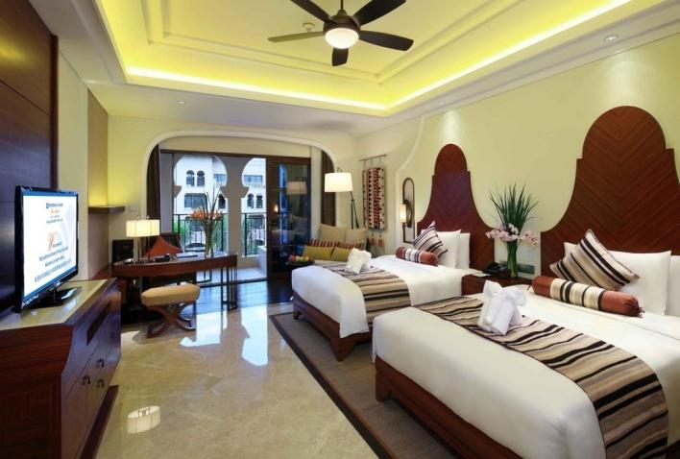
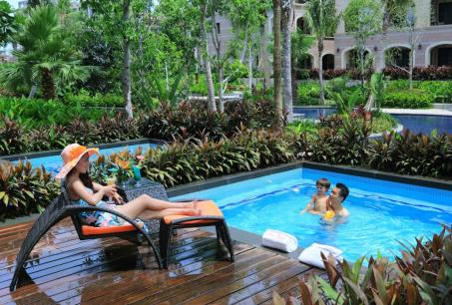
Stylish Guest Rooms & Suites
典雅客房 舒适体验
Superior Garden View Rooms 高级花园房
Superior room facilities with a hot spring bath tub on the balcony with lush garden views
尽赏酒店周边葱郁的园林美景，开阔的阳台设有观景温泉泡池
Deluxe Pool View Rooms 豪华池景房
Luxurious room decoration, well appointed with a hot spring bath tub on the balcony with pool views
尽赏酒店花园美景和清澈湛蓝的泳池景观，部分房间可赏怡人海景，室内装饰温馨典雅，开阔的阳台设有观景温泉泡池
Deluxe Pool Access Room 豪华池畔房
Get closer to the tropical oasis in your room with a private 15m² outdoor pool, enjoy a hot spring bath in the natural environment
在葱郁园林的簇拥下，花园美景近在咫尺，除阳台温泉泡池外，开阔的户外花园附设超大专属泡池，可尽情畅享特色泡浴

Slide 17
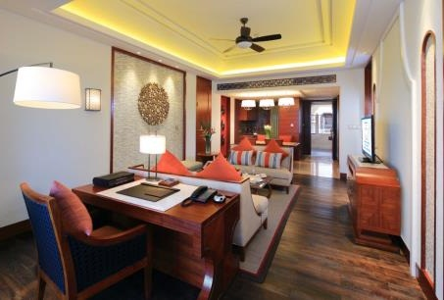
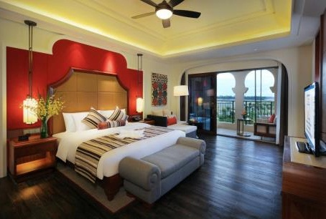
Stylish Guest Rooms & Suites
典雅客房 舒适体验
Superior Suite 高级套房
Superior room including a king bedroom, a living room, a kitchen with dining table with balconies overlooking the lush tropical gardens
房间包含1间豪华大床房、1间独立舒适客厅，1个用餐厅和两个开阔阳台，完善的客房设施，在享受阳台温泉泡浴时可尽赏葱郁热带园林美景
Deluxe Suite 豪华套房
Deluxe room including king bedroom, spacious living room, kitchen /dining room , well appointed with DVD player, coffee machine with balconies overlooking the lush tropical gardens and swimming pool.
房间包含1个豪华大床房、1间舒适客厅， 1个用餐厅和两个开阔阳台，温馨周到的客房设施配有DVD影碟机和咖啡机，在享受阳台温泉泡浴时可尽赏热带园林美景或湛蓝泳池景观

Slide 18
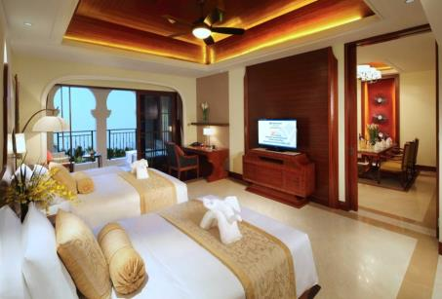
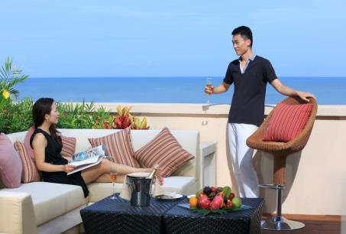
Stylish Guest Rooms & Suites
典雅客房 舒适体验
Deluxe Garden Suite 豪华花园套房
Deluxe room space including a king bedroom, a living room and dinning area, private open air garden balcony with Jacuzzi bathtub and Spa bed, enjoy the views of lush garden and Longmu Bay
客房包含1个豪华大床房、1个舒适客厅和1个私属户外花园，开阔阳台设有冲浪浴缸和SPA按摩椅，可在房间专享极致水疗呵护，尽赏热带园林美景和龙沐湾怡人海岸线
Deluxe Family Suite 豪华家庭套房
Spacious duplex including 1 king bedroom and 1 twin bedroom, living room, reading room, dining area, and a large balcony overlooking the Longmu Bay view - the best place for private parties
客房包含2个豪华卧室(1双1大)，1间舒适客厅、1个用餐厅和1间书房，适合您与家人共度温馨的天伦时光，亦或是和好友们欢聚在超大户外花园露台举办主题派对，尽赏热带园林美景和龙沐湾怡人海岸线

Slide 19
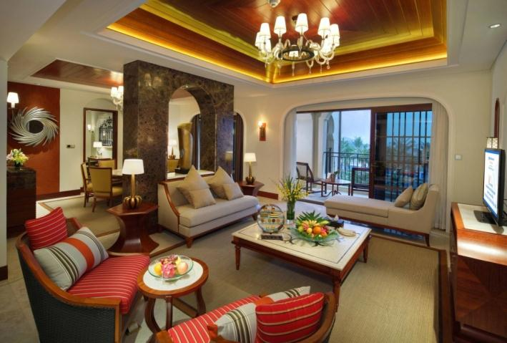
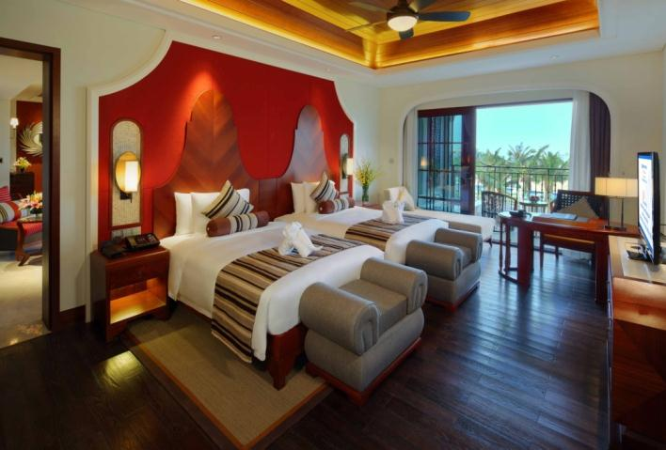
Stylish Guest Rooms & Suites
典雅客房 舒适体验
Wyndham Grand Suite 温德姆豪华大套房
Spacious suite including 1 king bedroom and 1 twin bedroom, living room, reading room, dining area, with balconies overlooking the lush gardens and Longmu Bay.
客房包含2个豪华卧室(1双1大)，1个超大客厅和1间书房，1个用餐厅和4个开阔阳台，户外冲浪浴缸和SPA椅，在房间即可专享极致水疗呵护，亦可俯瞰酒店花园美景和龙沐湾怡人海景
Presidential Suite 总统套房
Royale space including 1 king bedroom and 2 twin bedrooms, opulent living room, games room, dining area, enjoy the private swimming pool or bar on the patio, overlooking the Longmu Bay view
客房包含3个豪华卧室(1双2大)，1个超大客厅和1间游乐室，1个设备齐全的厨房和用餐厅，典雅尊贵的客房设施包含私家游泳池、超大入户花园，精致酒吧和观景平台，可尽赏热带园林美景和龙沐湾怡人海景

Slide 20
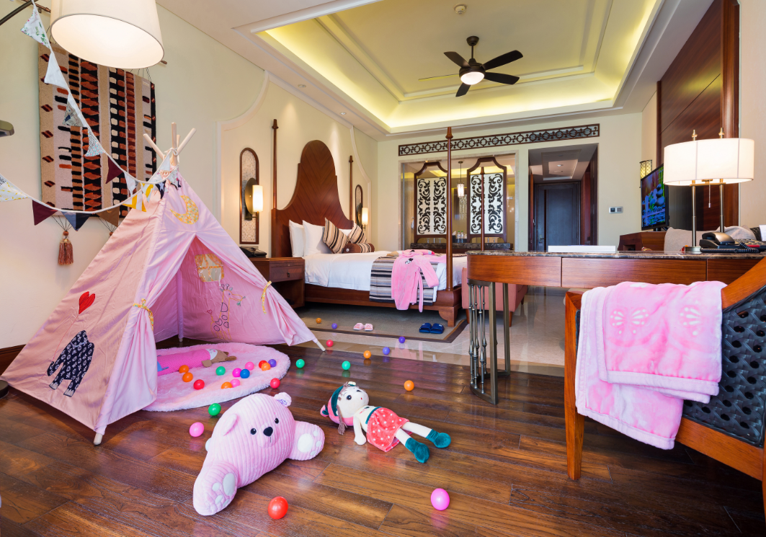
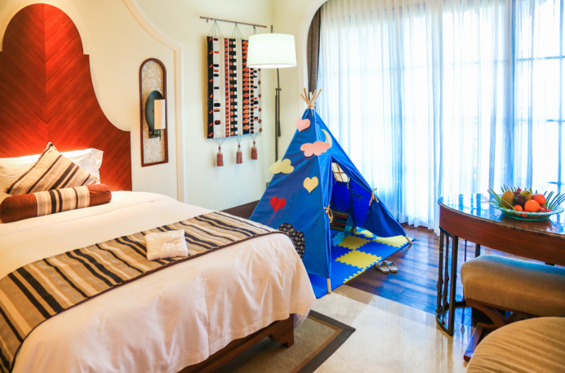
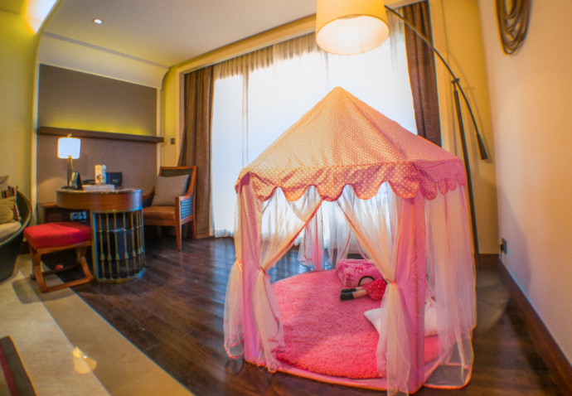
Stylish Guest Rooms & Suites
典雅客房 舒适体验
Family Room 亲子房
In this fairy world, there’s kid’s tent, kid’s bathrobe, kid’s bedding and toys and stuffs specially designed for children, which is an ideal option for family guests.
充满童话色彩的房间内配有亲子帐篷、儿童浴袍、儿童拖鞋、儿童床品、益智玩具等为儿童专属定制的物品，暖心的细节体现了对儿童的关怀，是家庭出游的理想选择

Slide 21
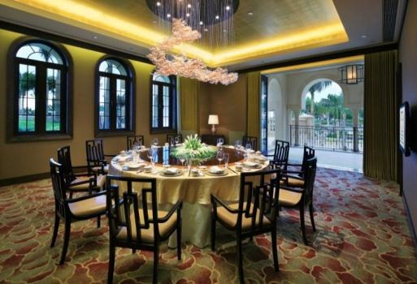
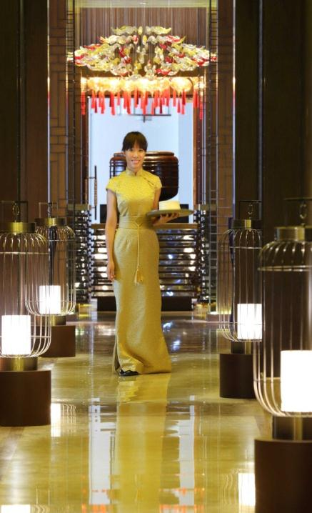
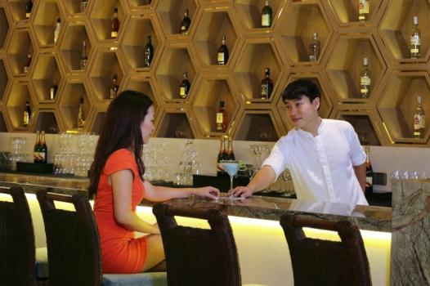
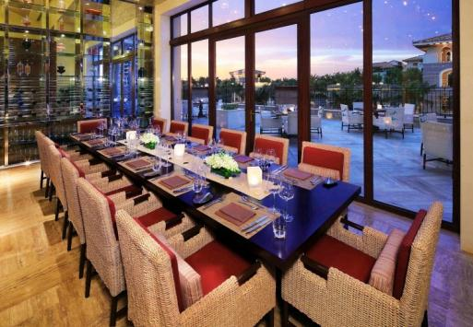
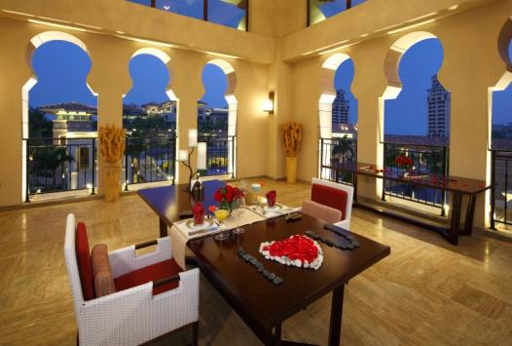
Restaurant & Lounges
餐厅与酒廊
Wyndham Grand Plaza Royale Hainan Longmu Bay, offers an appealing and thoughtfully conceived range of Chinese and International cuisines in a variety of venues designed to suit all tastes.
海南龙沐湾温德姆至尊豪廷大酒店拥有3个主题餐厅和3个特色酒吧，供应丰盛的中西式美食佳肴和美酒佳酿，满足客人的不同需求。

Slide 22

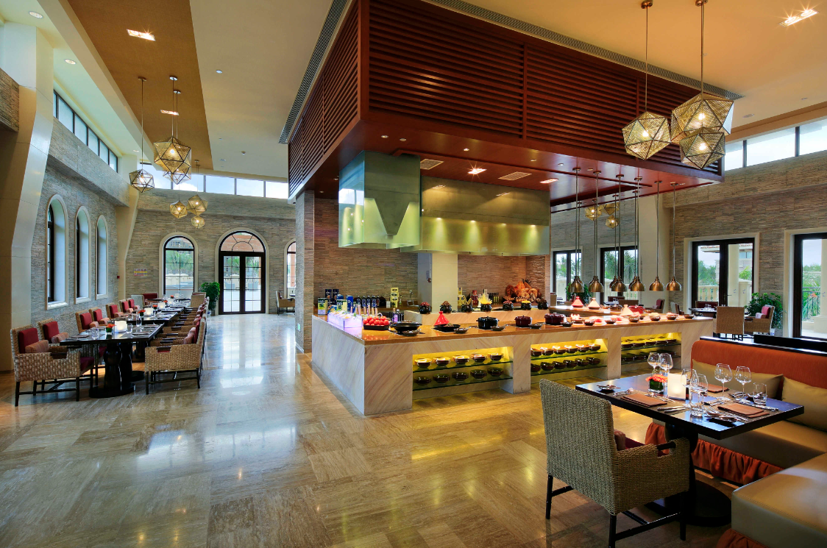
Restaurant & Lounges
餐厅与酒廊
Constellation All-day Dining Restaurant
星璨 全日制西餐厅
Constellation features the best of International cuisine when you want it. Open all day for dining in a vibrant & contemporary setting, diners can choose from an extensive a la carte selection or from its large buffet. The restaurant features four show kitchens offering freshly prepared dishes from around the world that focuses on fresh and enticing flavors.
全天候营业的星璨西餐厅，提供主厨精选零点菜单和丰盛的主题自助餐，随时准备着为您呈现国际美食盛宴。四个开放式厨房为您现场演绎美食的缔造过程。
Seats 席位：
270 seats & 1 PDR for 12 persons
270座和1个12座的包厢
Opening Hours 营业时间：
06:30am – 22:30pm
Location 地点：
Main Building 2F
酒店主楼二层
Telephone 电话：
0898 8559 8888 - 6222

Slide 23

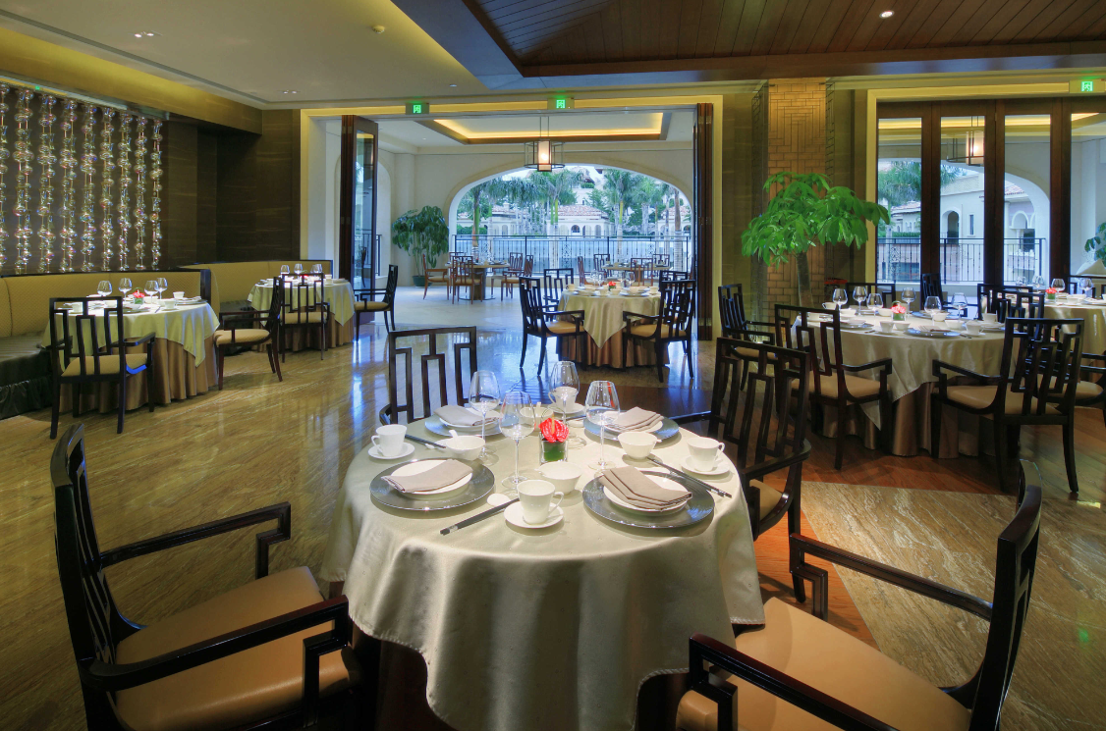
Restaurant & Lounges
餐厅与酒廊
Lotus Garden Chinese Restaurant
豪廷轩 中餐厅
Featuring the finest of Cantonese cuisine, Lotus Garden offers a timeless, elegant dining experience with beautiful views of the hotel gardens. Enjoy the large selection of the chef’s signature dishes, dim sum, and Hainanese specialties in a setting that evokes the grandeur of Chinese heritage.
豪廷轩中餐厅主理经典粤式佳肴，清新优雅的用餐环境中，可尽览风光无限的酒店花园景观。在品味大厨招牌菜的同时，精美点心和海南特色风味也将诱惑味蕾，带您赏味中华美食的博大精深。
Seats 席位：
132 seats & 8 PDR’s for 74 persons
132座，另有8个包厢可容纳74位
Opening Hours 营业时间：
午餐时段 Lunch: 11:30am – 14:30pm
晚餐时段 Dinner: 17:30pm – 22:00pm
Location 地点：
Main Building 1F
酒店主楼一层
Telephone 电话：
0898 8559 8888 - 6251

Slide 24

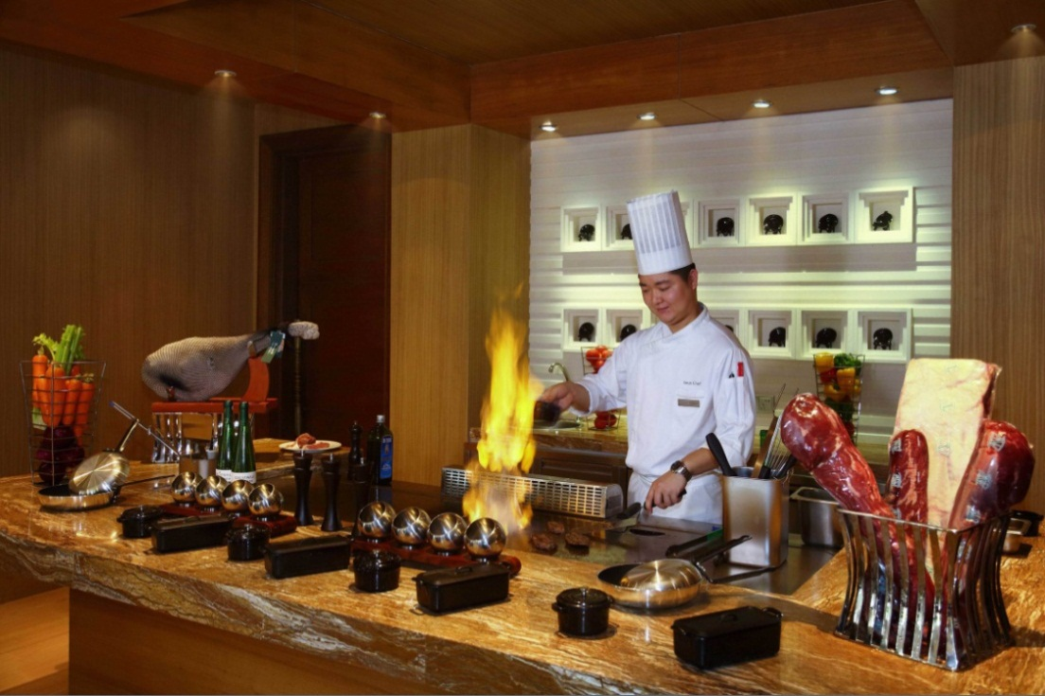
Restaurant & Lounges
餐厅与酒廊
Junsui Signature Restaurant
纯粹 特色餐厅
Offers an innovative grill menu of prime aged meat cuts or fresh seafood served cooked in front of you and prepared to your liking. With an emphasis on fresh, seasonal produce and the finest cuts of meat this authentic modern restaurant presents classic cuisine in a stylish but unpretentious setting.
时尚的纯粹特色餐厅只为展现最经典创新的特色美食，从金牌肉类到生猛海鲜，均可选择您喜爱的烹饪方式现场制作，让最新鲜的节令食材，创意出最鲜活的美味体验。
Seats 席位：
45 seats & 1 PDR for 6 persons
45座和1个6座的包厢
Location 地点：
Main Building 1F
酒店主楼一层
Telephone 电话：
0898 8559 8888 - 6202

Slide 25

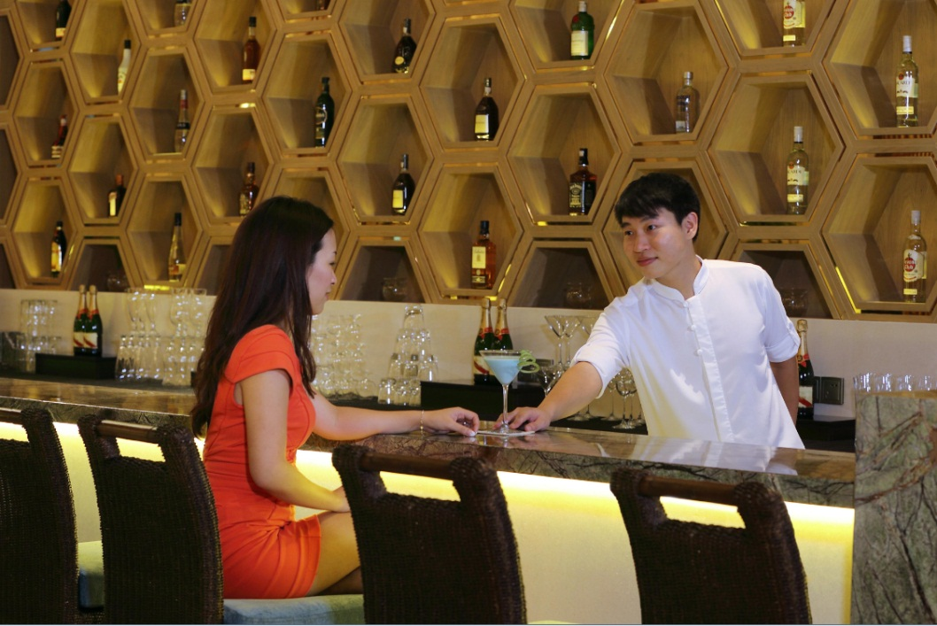
Restaurant & Lounges
餐厅与酒廊
Breeze Way Lobby Lounge
遊廊 大堂吧
The Breeze Way is a relaxed and casual lounge, open all day for variety of fresh fruit smoothies, hip cocktails and a la carte menu. The setting is perfect for a delightful time with family, friends or colleagues. In the evening, sip on exquisite cocktails under the starry skies on the outdoor terrace, or on Breeze Ways’ own reflecting pool.
遊廊大堂吧是亲友小聚，商旅会面的好去处，全天候为您提供新鲜水果沙冰、特调鸡尾酒等多种饮品和可口小食。或在户外露台的明朗星空下，度过一个迷人的夜晚。
Seats 席位：
80 seats in door & 30 seats in terrace
室内80座，户外露台30座
Opening Hours 营业时间：
13:00pm – 23:00pm
Location 地点：
Hotel Lobby
酒店大堂
Telephone 电话：
0898 8559 8888 - 6236

Slide 26

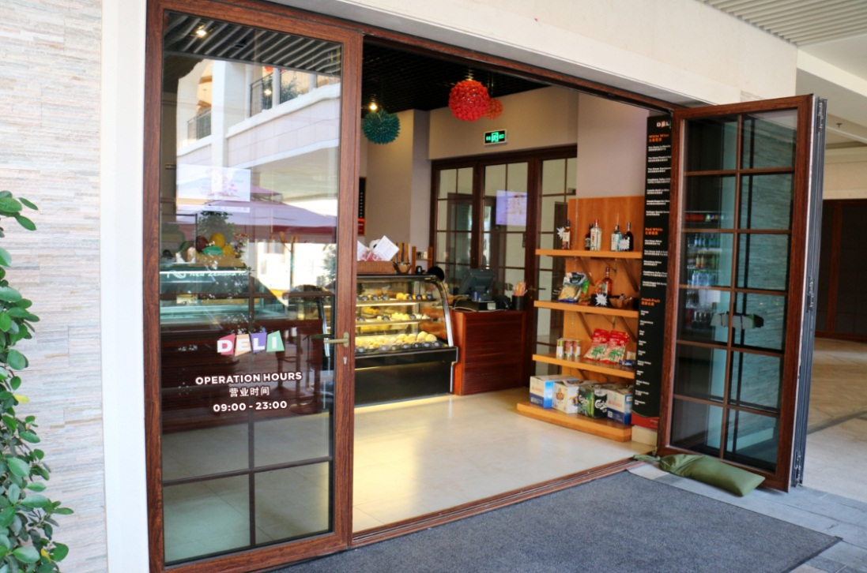
Restaurant & Lounges
餐厅与酒廊
The Deli
便利店
This delicatessen offers a wide selection of fresh breads, pastries and an exquisite array of made-to-order gourmet items. The Deli is also the hotel’s mini mart which is excellent for a quick snack or for picking up some take-away before a day in the sun.
便利店每日出品多种口味的鲜烤面包和美味甜点，立等可取，或根据您的节日需求，预约定制美食。便利店犹如酒店里的迷你超市，丰富的速食小吃、披萨咖啡等，让您的度假生活轻松便捷。
Seats 席位：
30 seats in the outdoor
30个户外座位
Opening Hours 营业时间：
10:30am – 23:00pm
Location 地点：
Grand Promenade
运河至尊大道
Telephone 电话：
0898 8559 8888 - 6299

Slide 27

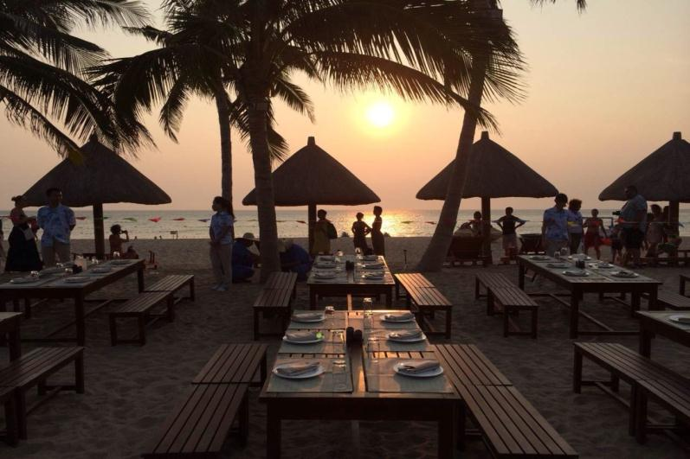
Restaurant & Lounges
餐厅与酒廊
Beach Bar
沙滩吧
The epitome of a casual beachside bar, the Sand Bar offers icy cold beers, wines, wide selection of cocktails and divine snacks. In the early evening, be captivated by the Longmu Bay sunset views from the bar, undoubtedly the most beautiful in China.
沙滩吧为您特别供应冰爽啤酒、各类红酒、缤纷鸡尾酒和精致小食，悦享便捷与惬意。亦或在夜幕降临前，陶醉在中国最美
落日的余晖里，尽享浪漫流年。
Seats 席位：
50 seats
50座
Location 地点：
Hotel Private Beach
酒店专属海滩
Telephone 电话：
0898 8559 8888 - 6202

Slide 28
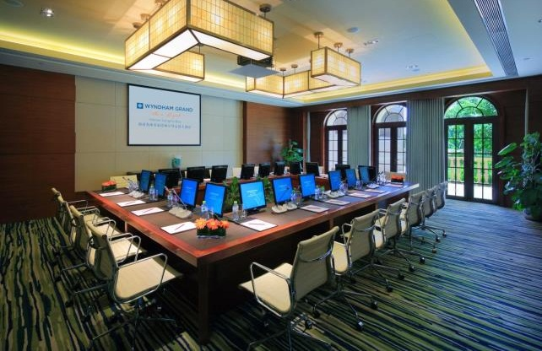
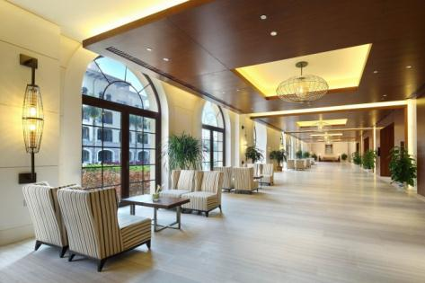
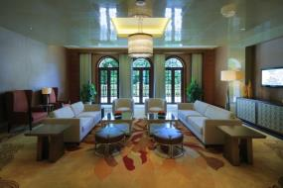
Meetings & Events
会议及宴会
The hotel has over 1,800sqm of versatile meeting and convention space. Additionally, there is plenty of pre-function and outdoor space, such as pool areas and open gardens which are idyllic for cocktail parties and wedding receptions.
酒店拥有超过1,800平方米会议场地，开阔的会议室前厅和多个户外宴会活动场地，池畔区域和葱郁草坪，为风情鸡尾酒会和浪漫婚礼仪式，创造独特氛围。

Slide 29
Meeting Rooms Capacity
会议室容量表
Meeting rooms | 会议室名称 | Dimension 规 格 |  | Capacity 容 纳 量
 |  | Area 面积 (m²) | Height 高 (m) | Theatre 剧院式 | Class-room 课桌式 | U-shape U 型 | Banquet 宴会式 | Cocktail reception 鸡尾酒会
Grand Ballroom | 温德姆大宴会厅 | 1080 | 9.3 | 1200 | 750 | - | 680 | 1000
Grand Ballroom I | 大宴会厅 I | 353 | 9.3 | 300 | 200 | - | 200 | 300
Grand Ballroom II | 大宴会厅 II | 374 | 9.3 | 300 | 200 | - | 200 | 300
Grand Ballroom III | 大宴会厅 III | 353 | 9.3 | 300 | 200 | - | 200 | 300
VIP Room | 贵宾接待室 | 64 | 3 | - | - | 20 (BM) | - | -
Board Room | 董事会型会议室 | 88 | 3 | - | - | 20 (BM) | - | -
Function Room | 多功能厅 | 236 | 7.1 | 220 | 120 | - | 120 | 320
Function Room 1 | 多功能厅 1 | 118 | 7.1 | 120 | 50 | 40 | 60 | 70
Function Room 2 | 多功能厅 2 | 118 | 7.1 | 120 | 50 | 40 | 60 | 70
Meeting Room A | 会议室 A | 174 | 3.3 | 180 | 100 | - | 130 | 100
Meeting Room 1 | 会议室 1 | 87 | 3.3 | 80 | 40 | 30 | 40 | 50
Meeting Room 2 | 会议室 2 | 87 | 3.3 | 80 | 40 | 30 | 40 | 50
Meeting Room B | 会议室 B | 157 | 3.5 | 150 | 70 | - | 80 | 100
Meeting Room 3 | 会议室 3 | 77 | 3.5 | 80 | 40 | 20 | 40 | 50
Meeting Room 4 | 会议室 4 | 80 | 3.5 | 80 | 40 | 20 | 40 | 50

Slide 30
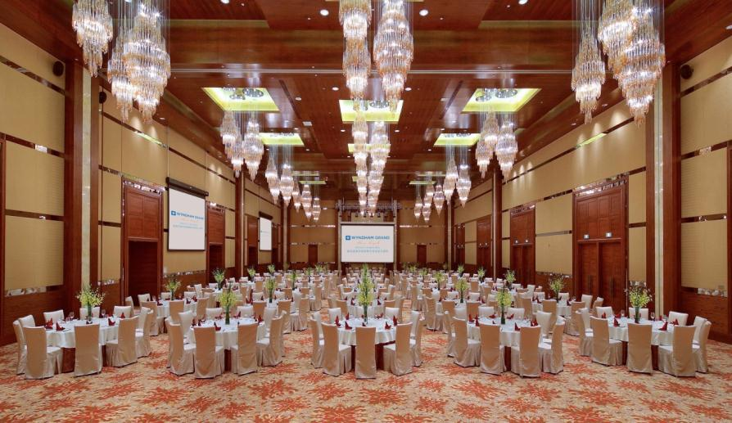
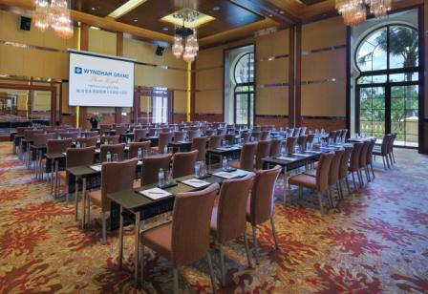
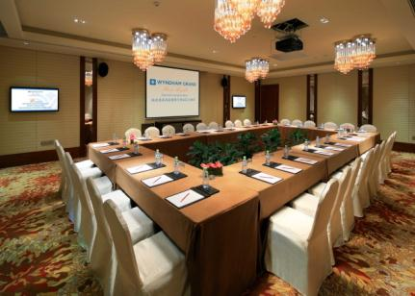
Meetings & Events
会议及宴会
Meeting Facilities：
Audio System
High-speed Broadbannd Internet
Digital Projector and screen
Movable Stage
Lectern
Microphone
Whiteboard
Flipchart
会议设施：
音频系统
无线和有线网络接入
多媒体投影仪和幕布
可移动舞台
讲台
麦克风
白板
挂纸白板

Slide 31

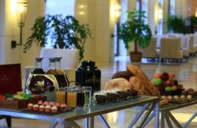


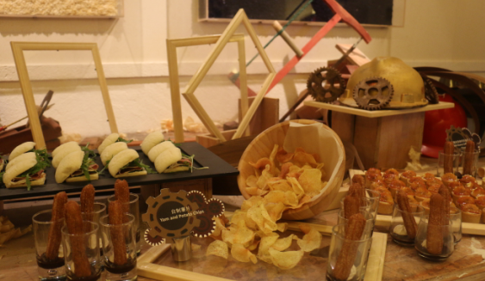
Innovative Theme Breaks
乐享会议的每个瞬间
Relax in between meetings through one of our unique theme breaks
会议间歇时段，放松身心，在细节中发现惊喜
Themed coffee breaks
Relaxing massages
VIP lounge
Surfing the Internet
主题创意茶歇
放松舒缓按摩
贵宾休息室
网上冲浪

Slide 32
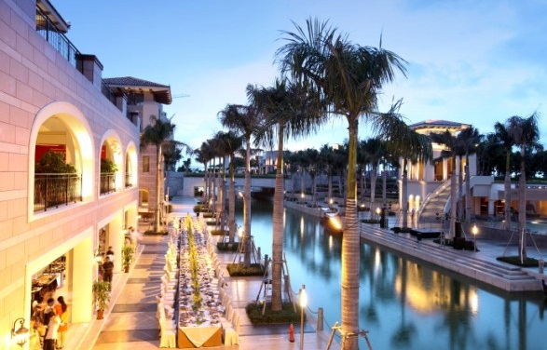
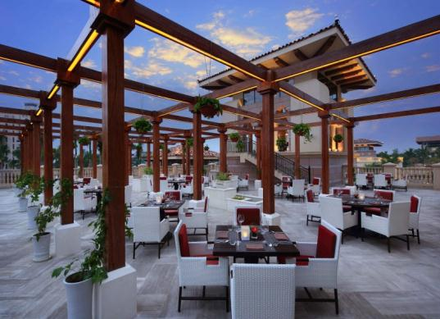
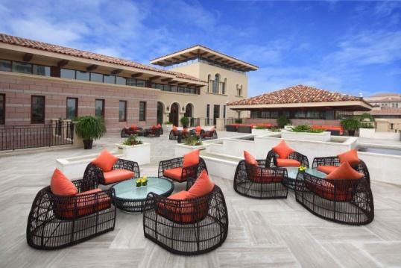
Outdoor Dining Experience
充满奇趣的户外用餐体验
Make your banquet & wedding event more memorable
为宴会和用餐活动提供不可复制的精彩体验
Private beach
Grand Promenade
Constellation terrace & PDR
Breeze Way terrace
专属海滩（最美落日海滩）
风情运河 至尊大道
星璨 露台和海景包厢
遊廊 露台

Slide 33

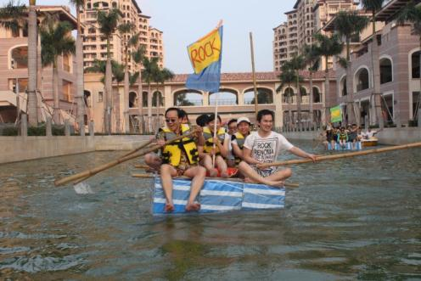




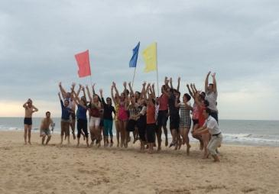
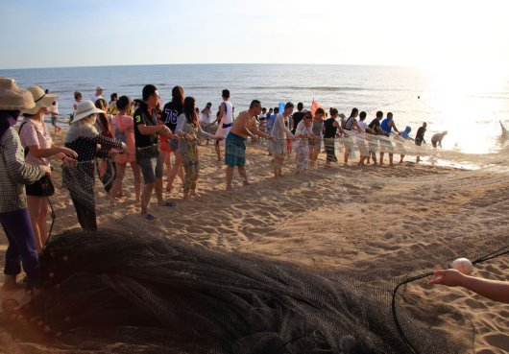
Team Building of Unique Style
独具特色的团队拓展体验
Hotel professional S&R team will design team building activities which is tailor made to your distinctive need
从策划、准备到现场执行，酒店专业的康乐团队可提供拓展活动专属定制服务
Bamboo rafting
Happy fishermen
World War
We Are on the Same Boat
竹筏漂流
拖网捕鱼
世界大战
同舟共济

Slide 34
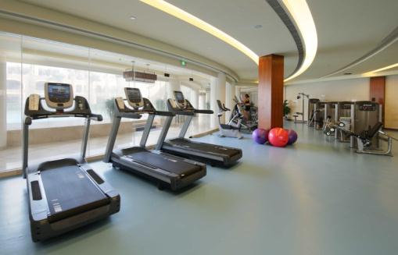

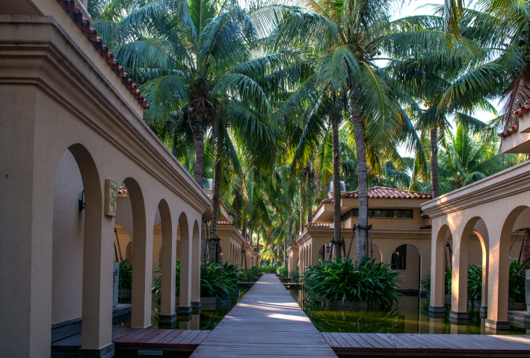

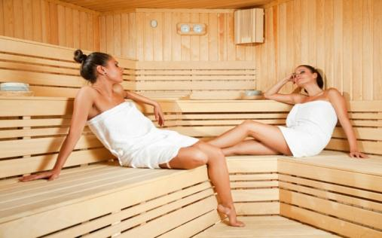


Diversified Leisure & Entertainments
精彩丰富的康乐休闲活动
Fitness Center
健身中心
With exercise equipment, yoga room, independent locker & sauna
配备最新健身器材、瑜伽室和桑拿房
Little Dolphin Kid’s Club
海豚乐园
Providing both indoor & outdoor playground and daily activities
室内和户外游乐场地，每日儿童活动
Noah Touch Spa
愉尊会水疗中心
Providing professional spa treatment, facial & foot massage
提供专业水疗护理、面部理疗和足浴

Slide 35






Diversified Leisure & Entertainments
精彩丰富的康乐休闲活动
Bicycle Tour in tropical garden
热带花园骑行
Tennis Court
网球场
Billiards Games Room
桌球娱乐室
Water Sports in the Canal
风情运河游船观光
KTV room rental
KTV 欢唱包厢
Mahjong private room
麻将包房

Slide 36



Swimming Pools
主题泳池
There are three outdoor Swimming Pools in hotel include the Main pool with waterfall feature, the South pool with a Jacuzzi, and the North pool.
酒店共有3个主题泳池，包含瀑布景观主泳池、设有冲浪按摩区的南池以及北池，均提供丰富的水上
活动项目。

Slide 37




Exciting Beach Club
活力四射的沙滩俱乐部
Well equipped hotel beach area has umbrellas and sunbeds for in house guests’ exclusive use. We also offer exciting water sports for you enjoy the sunshine and sea breeze, or dive into the waves.
原始淳美的酒店海滩区域，有专为住店客人设置的阳伞和沙滩椅，可在海浪声声中品味充满阳光的滨海度假时光，
也可以踏浪嬉戏，享受亲近大自然的美妙时刻。精彩刺激的海上活动项目，待您领略不一般的水中体验。

Slide 38




Wyndham Organic Farm
温德姆有机庄园
The Wyndham Organic Farm is a fun filed natural place where the guest can pick green and fresh vegetables, experience farming activities, go fishing, as well as take interacting with little animals.
回归大自然，乐活田园间，尽在温德姆有机庄园，客人可以于此亲手采摘绿色无污染的有机鲜蔬，体验农耕的乐趣，
悠哉垂钓，或者与小动物们逗趣互动，悦享阳光下的田园假期。

Slide 39



Fantasy Sand Sculpture
梦幻沙雕乐园
The Fantasy Sand Sculpture is located on the hotel private beach featured by various famous cartoon characters, and offering a series of activities on the sands for the families.
酒店的专属海滩上，还有一个梦幻沙雕乐园可供住店客人免费游玩，众多经典卡通人物带您畅游梦幻童心乐园，
并提供一系列沙滩亲子互动游戏，可供全家参与。

Slide 40

Welcome to the Wyndham Grand Plaza Royale
Hainan Longmu Bay!
海南龙沐湾温德姆至尊豪廷大酒店 诚挚恭候您的光临！

Slide 41

Contact Us
联系我们
Rose Zhao
赵静
Director of Sales & Marketing
市场销售总监
Phone 联系电话：139 2066 8634
(86 898) 8559 8888 - 6900
Email address 邮箱：
Rose.zhao@wyndhamgpr.com
Wyndham Grand Plaza Royale Hainan Longmu Bay
海南龙沐湾温德姆至尊豪廷大酒店
Longmu Bay International Resort District, Ledong County 572541,
Hainan Province, P. R. China
中国海南省乐东龙沐湾国际旅游度假区 邮编：572541
Tel电话: (86 898) – 8559 8888 Fax传真: (86 898) – 8559 8610
Email邮箱: info.longmubay@wyndhamgpr.com
Website网址: www.wyndhamgpr.com

Slide 42


